Slide 1
Chapter 11
Public Goods and Common Resources
Professor Galvez-Soriano lecture notes. Based on N. Gregory Mankiw, Principles of Microeconomics, 9th Edition.

Slide 2
Definitions
Excludability
Property of a good whereby a person can be prevented from using it
Rivalry in consumption
Property of a good whereby one person’s use diminishes other people’s use
Professor Galvez-Soriano lecture notes. Based on N. Gregory Mankiw, Principles of Microeconomics, 9th Edition.
Notes:
By which

Slide 3
The Different Kinds of Goods
Private goods
Excludable & Rival in consumption
Public goods
Not excludable & Not rival in consumption
Common resources
Rival in consumption & Not excludable
Club goods
Excludable & Not rival in consumption
One type of natural monopoly
Professor Galvez-Soriano lecture notes. Based on N. Gregory Mankiw, Principles of Microeconomics, 9th Edition.

Slide 4
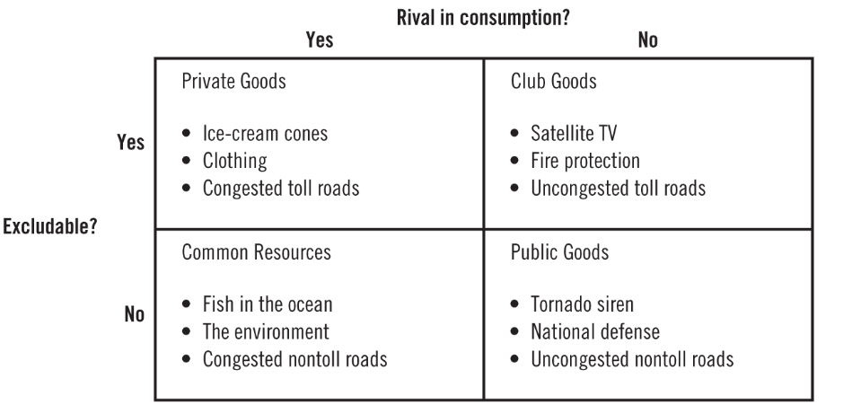
Figure 1 Four Types of Goods
Professor Galvez-Soriano lecture notes. Based on N. Gregory Mankiw, Principles of Microeconomics, 9th Edition.

Slide 5
The Different Kinds of Goods
Public goods and common resources
Not excludable
People cannot be prevented from using them
Available to everyone free of charge
No price attached to it
External effects
Positive externalities (public goods)
Negative externalities (common resources)
Professor Galvez-Soriano lecture notes. Based on N. Gregory Mankiw, Principles of Microeconomics, 9th Edition.

Slide 6
The Different Kinds of Goods
Public goods and common resources
Private decisions about consumption and production
Can lead to an inefficient allocation of resources
Government intervention
Can potentially raise economic well-being
Professor Galvez-Soriano lecture notes. Based on N. Gregory Mankiw, Principles of Microeconomics, 9th Edition.

Slide 7
Public Goods
Free rider
Person who receives the benefit of a good but avoids paying for it
The free-rider problem
Public goods are not excludable
Prevents the private market from supplying the goods
Market failure
Professor Galvez-Soriano lecture notes. Based on N. Gregory Mankiw, Principles of Microeconomics, 9th Edition.

Slide 8
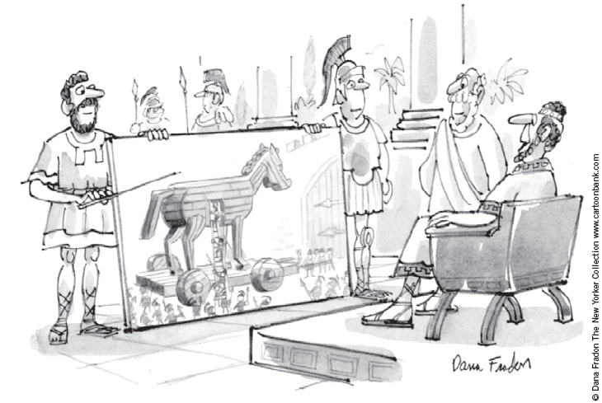
Public Goods
Government can remedy the free-rider problem
If total benefits of a public good exceeds its costs
Provide the public good
Pay for it with tax revenue
Make everyone better off
“I like the concept if we can do it with no new taxes.”
Professor Galvez-Soriano lecture notes. Based on N. Gregory Mankiw, Principles of Microeconomics, 9th Edition.

Slide 9
Public Goods
Some important public goods
National defense
Very expensive public good
$744 billion in 2017
Basic research
General knowledge
Subsidized by government
The public sector fails to pay for the right amount and the right kinds
Professor Galvez-Soriano lecture notes. Based on N. Gregory Mankiw, Principles of Microeconomics, 9th Edition.

Slide 10
Public Goods
Some important public goods
Antipoverty programs financed by taxes
Welfare system (Temporary Assistance for Needy Families program, TANF)
Provides a small income for some poor families
Food stamps (Supplemental Nutrition Assistance Program, SNAP)
Subsidize the purchase of food for those with low incomes
Government housing programs
Make shelter more affordable
Professor Galvez-Soriano lecture notes. Based on N. Gregory Mankiw, Principles of Microeconomics, 9th Edition.

Slide 11
Public Goods
The difficult job of cost–benefit analysis
Government
Decide what public goods to provide
In what quantities
Cost–benefit analysis
Compare the costs and benefits to society of providing a public good
Doesn’t have any price signals to observe
Government findings: rough approximations at best
Professor Galvez-Soriano lecture notes. Based on N. Gregory Mankiw, Principles of Microeconomics, 9th Edition.

Slide 12
Common Resources
Common resources
Not excludable
Rival in consumption
The tragedy of the commons
Parable that shows why common resources are used more than desirable
From society’s standpoint
Social and private incentives differ
Arises because of a negative externality
Professor Galvez-Soriano lecture notes. Based on N. Gregory Mankiw, Principles of Microeconomics, 9th Edition.

Slide 13
Common Resources
The tragedy of the commons
Negative externality
One person uses a common resource diminishes other people’s enjoyment of it
Common resources tend to be used excessively
Government can solve the problem
Regulation or taxes to reduce consumption of the common resource
Turn the common resource into a private good
Professor Galvez-Soriano lecture notes. Based on N. Gregory Mankiw, Principles of Microeconomics, 9th Edition.

Slide 14
Common Resources
Some important common resources
Clean air and water
Negative externality: pollution
Regulations or corrective taxes
Congested roads
Negative externality: congestion
Corrective tax: charge drivers a tool
Tax on gasoline
Professor Galvez-Soriano lecture notes. Based on N. Gregory Mankiw, Principles of Microeconomics, 9th Edition.

Slide 15
Common Resources
Some important common resources
Fish, whales, and other wildlife
Oceans: the least regulated common resource
Needs international cooperation
Difficult to enforce an agreement
Fishing and hunting licenses
Limits on fishing and hunting seasons
Limits on size of fish
Limits on quantity of animals killed
Professor Galvez-Soriano lecture notes. Based on N. Gregory Mankiw, Principles of Microeconomics, 9th Edition.

Slide 16
Importance of Property Rights
Market fails to allocate resources efficiently
Because property rights are not well established
Some item of value does not have an owner with the legal authority to control it
Professor Galvez-Soriano lecture notes. Based on N. Gregory Mankiw, Principles of Microeconomics, 9th Edition.

Slide 17
Importance of Property Rights
The government can potentially solve the problem
Help define property rights and thereby unleash market forces
Regulate private behavior
Use tax revenue to supply a good that the market fails to supply
Professor Galvez-Soriano lecture notes. Based on N. Gregory Mankiw, Principles of Microeconomics, 9th Edition.

Slide 18
Wednesday class
Professor Galvez-Soriano lecture notes. Based on N. Gregory Mankiw, Principles of Microeconomics, 9th Edition.

Slide 19
Voluntary contributions toward a public good
Setup
Amy and Deborah are considering contributing toward the creation of a botanical garden. Each can choose whether to contribute $200 to the botanical garden or to keep that $200 for a new suit.
Since a botanical garden is a public good, both Amy and Deborah will benefit from any contributions made by the other person. Specifically, every dollar that either one of them contributes will bring each of them $0.60 of benefit.
$200*0.6=$120 each
Professor Galvez-Soriano lecture notes. Based on N. Gregory Mankiw, Principles of Microeconomics, 9th Edition.

Slide 20
Voluntary contributions toward a public good
Deborah
Contribute
Doesn’t contribute
__, | __,
__, | __,
C
Amy
DC
Professor Galvez-Soriano lecture notes. Based on N. Gregory Mankiw, Principles of Microeconomics, 9th Edition.
Notes:
The greatest combined benefits to Amy and Deborah are obtained when both Amy and Deborah contribute to the botanical garden.

Slide 21
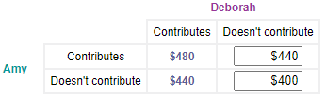
Voluntary contributions toward a public good
Since a new suit is a private good, if Amy chooses to spend $200 on a new suit, Amy would get $200 of benefit from the new suit and Deborah wouldn't receive any benefit from Amy's choice. Hence, the combined benefits of Amy and Deborah:
Professor Galvez-Soriano lecture notes. Based on N. Gregory Mankiw, Principles of Microeconomics, 9th Edition.
Notes:
The greatest combined benefits to Amy and Deborah are obtained when both Amy and Deborah contribute to the botanical garden.

Slide 22
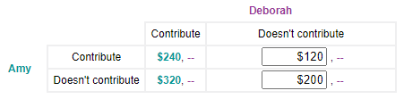
Voluntary contributions toward a public good
Now consider the individual benefit data for Amy:
Free rider problem!
Professor Galvez-Soriano lecture notes. Based on N. Gregory Mankiw, Principles of Microeconomics, 9th Edition.
Notes:
If Deborah decides to contribute to the botanical garden, Amy would maximize her benefit by choosing not to contribute to the botanical garden. On the other hand, if Deborah decides not to contribute to the botanical garden, Amy would maximize her benefit by choosing not to contribute to the botanical garden.

